Slide 1

Algorithm in Search Engine
Rao, Vicky Yue / Digital
2024/1/31

Slide 2
Agenda
PART 1
Basic Search
PART 2
AI Powered Search
PART 3
Multimodal Search
PART 4
Prospect

Slide 3
01
Basic Search

Slide 4



Basic Search
Search is everywhere in our daily lives!
Google search
E-commerce platform
Knowledge base

Slide 5
Basic Search
What is the processes of search engines?
Web crawling
Indexing
Ranking
Then when the user searches, the job of the search engine is to provide the content the user wants to find based on the user's search terms.
Search Queries
Document Rankings
Notes:
比较直观地看，从用户输入query再到网站给出结果，主要包括这两点

Slide 6
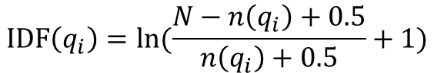
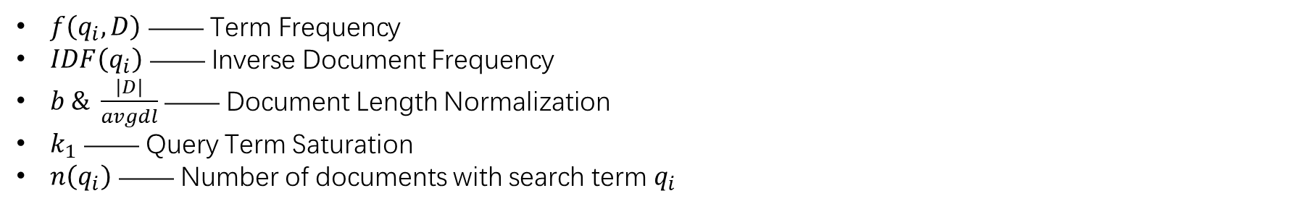
Basic Search
BM25(Best Match 25) Algorithm
A ranking function used by search engines to estimate the relevance of documents to a given search query.
$$score\left(D,Q\right)= \sum_{i=1}^{n}{IDF(q_{i})∙\frac{f(q_{i},D)∙(k_{1}+1)}{f\left(q_{i},D\right)+k_{1}∙(1−b+b∙\frac{\left|D\right|}{avgdl})}}$$
$$IDF\left(q_{i}\right)=ln(\frac{N−n\left(q_{i}\right)+0.5}{n\left(q_{i}\right)+0.5}+1)$$
$f\left(q_{i},D\right)$ —— Term Frequency
$IDF\left(q_{i}\right)$ —— Inverse Document Frequency
$b \& \frac{\left|D\right|}{avgdl}$ —— Document Length Normalization
$k_{1}$ —— Query Term Saturation
$n\left(q_{i}\right)$ —— Number of documents with search term $q_{i}$

Slide 7
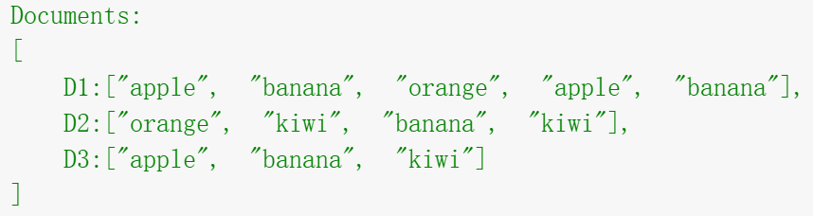

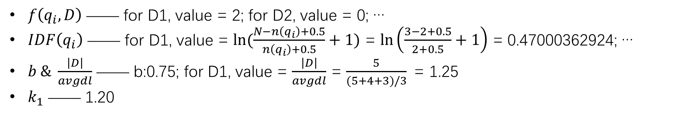
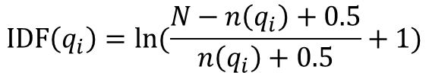
Basic Search
BM25(Best Match 25) Algorithm
$$score\left(D,Q\right)= \sum_{i=1}^{n}{IDF(q_{i})∙\frac{f(q_{i},D)∙(k_{1}+1)}{f\left(q_{i},D\right)+k_{1}∙(1−b+b∙\frac{\left|D\right|}{avgdl})}}$$
$$IDF\left(q_{i}\right)=ln(\frac{N−n\left(q_{i}\right)+0.5}{n\left(q_{i}\right)+0.5}+1)$$
$f\left(q_{i},D\right)$ —— for D1, value = 2; for D2, value = 0; …
$IDF\left(q_{i}\right)$ —— for D1, value = $ln(\frac{N−n\left(q_{i}\right)+0.5}{n\left(q_{i}\right)+0.5}+1)$ = $ln\left(\frac{3−2+0.5}{2+0.5}+1\right)$ = 0.47000362924; …
$b \& \frac{\left|D\right|}{avgdl}$ —— b:0.75; for D1, value = $\frac{\left|D\right|}{avgdl}$ = $\frac{5}{(5+4+3)/3}$ = 1.25
$k_{1}$ —— 1.20
$score\left(D1,Q\right)= \sum_{i=1}^{n}{IDF(q_{i})∙\frac{f(q_{i},D1)∙(k_{1}+1)}{f\left(q_{i},D1\right)+k_{1}∙(1−b+b∙\frac{\left|D1\right|}{avgdl})}}$ = $\sum_{i=1}^{1}{0.47∙\frac{2∙(1.2+1)}{2+1.2∙(1−0.75+0.75∙1.25)}}$ = 0.60379562043

Slide 8
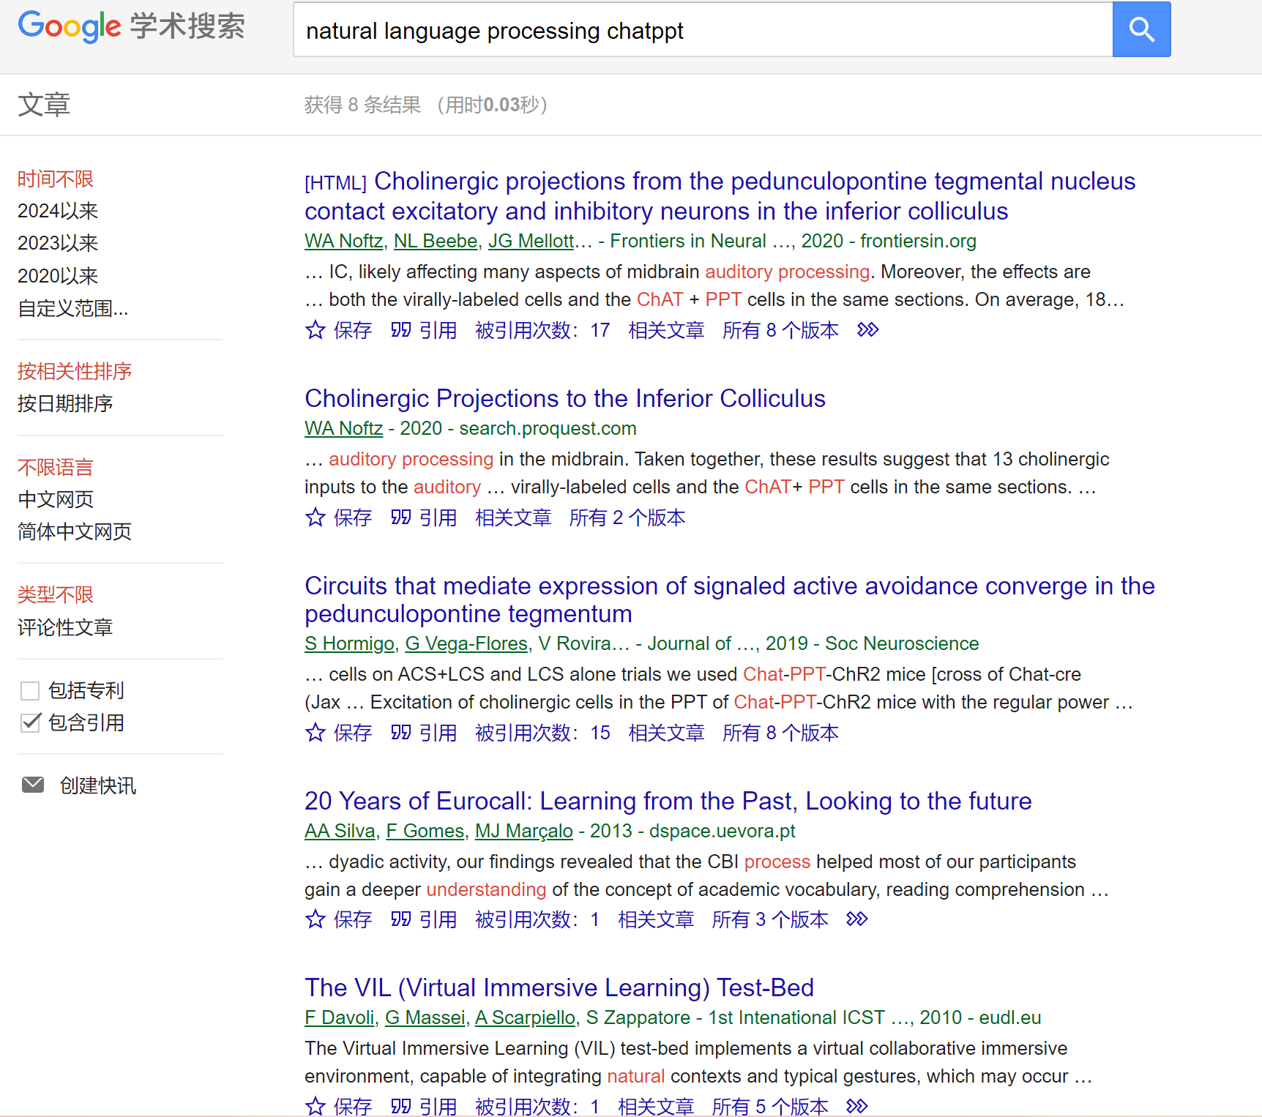
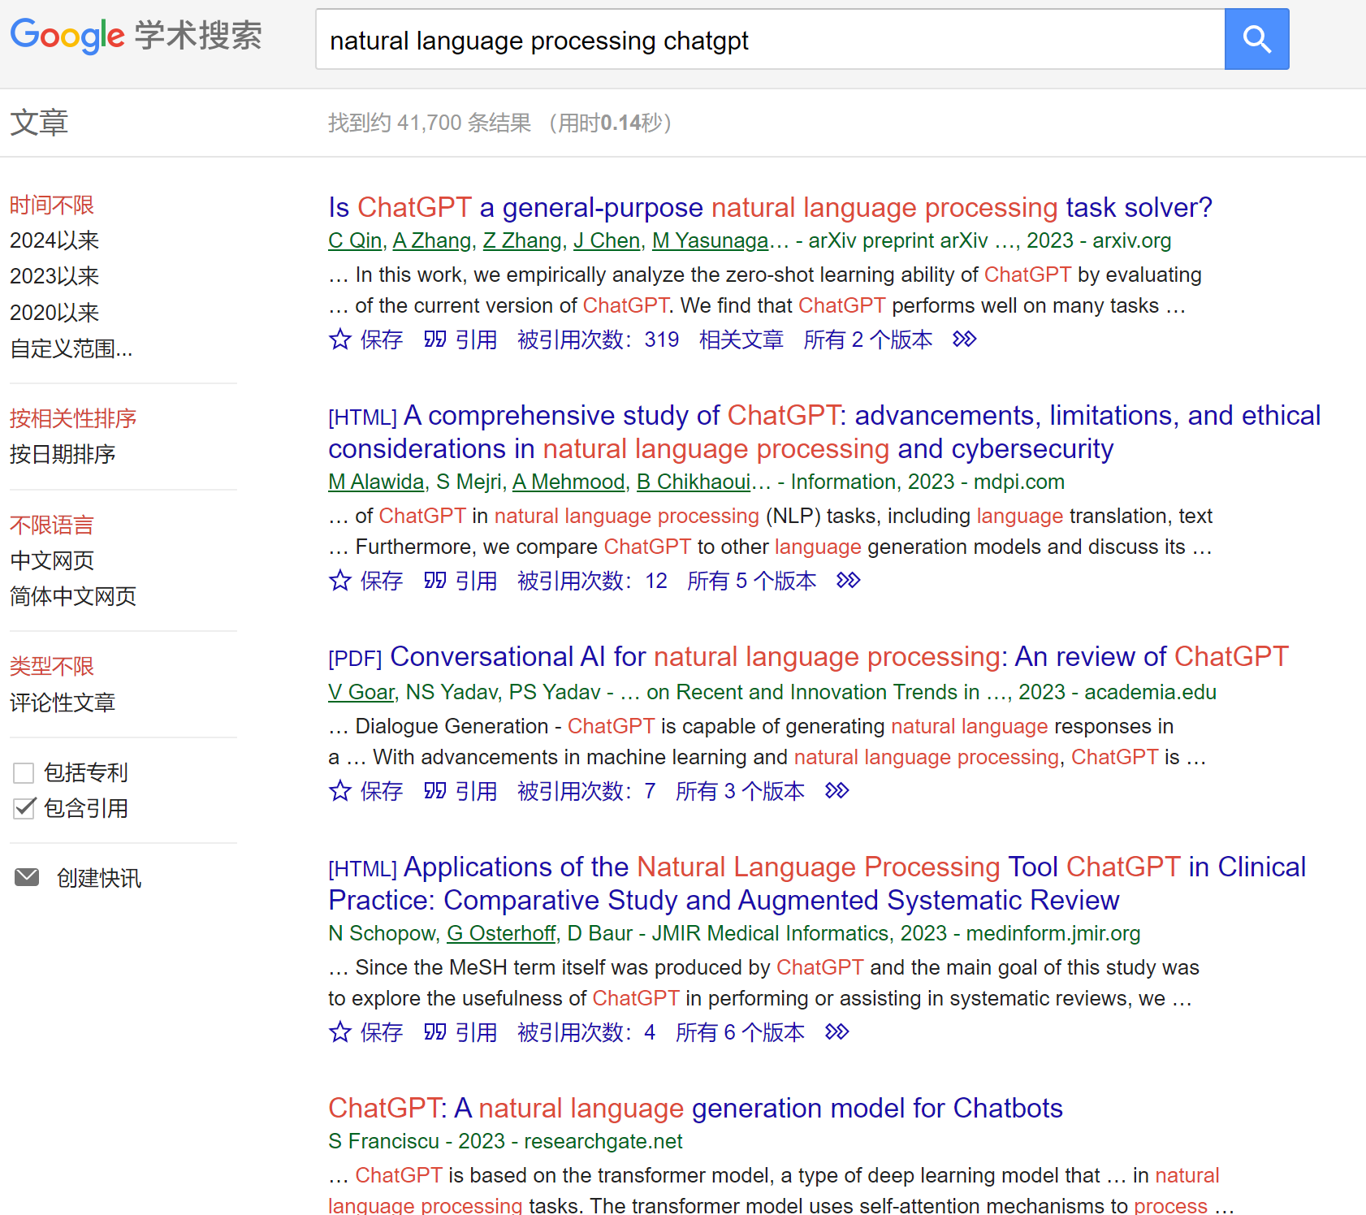
Basic Search
The engine gives search results based on user query

Slide 9
02
AI Powered Search

Slide 10
AI Powered Search
Search Engine History
1990s: Birth of search engines
2010s: AI Ranking-Neural networks and deep learning
Late 2000s: The rise of semantics and natural language search
1996: Birth of Google
2020s: Generative search experiences
…
https://www.oslash.com/blog/history-evolution-of-web-search

Slide 11

AI Powered Search
When we talk about AI for search, what does that mean?
The emergence of large language models, such as ChatGPT, has transitioned the focus from mere keyword-based searches to a more sophisticated understanding of user intent.
Semantic Search Algorithms like Google’s BERT algorithm exemplifies the application of AI in discerning the context of words in search queries. Unlike conventional keyword-based search, BERT scrutinizes the relationships between words in a query, grasping nuances and subtleties.
Apply new AI technology to all aspects of search engines

Slide 12
03
Multimodal Search

Slide 13
New Ways to Search
Multisearch(left) and circle to search(right)
https://blog.google/products/search/google-search-ai-january-2024-update/

Slide 14
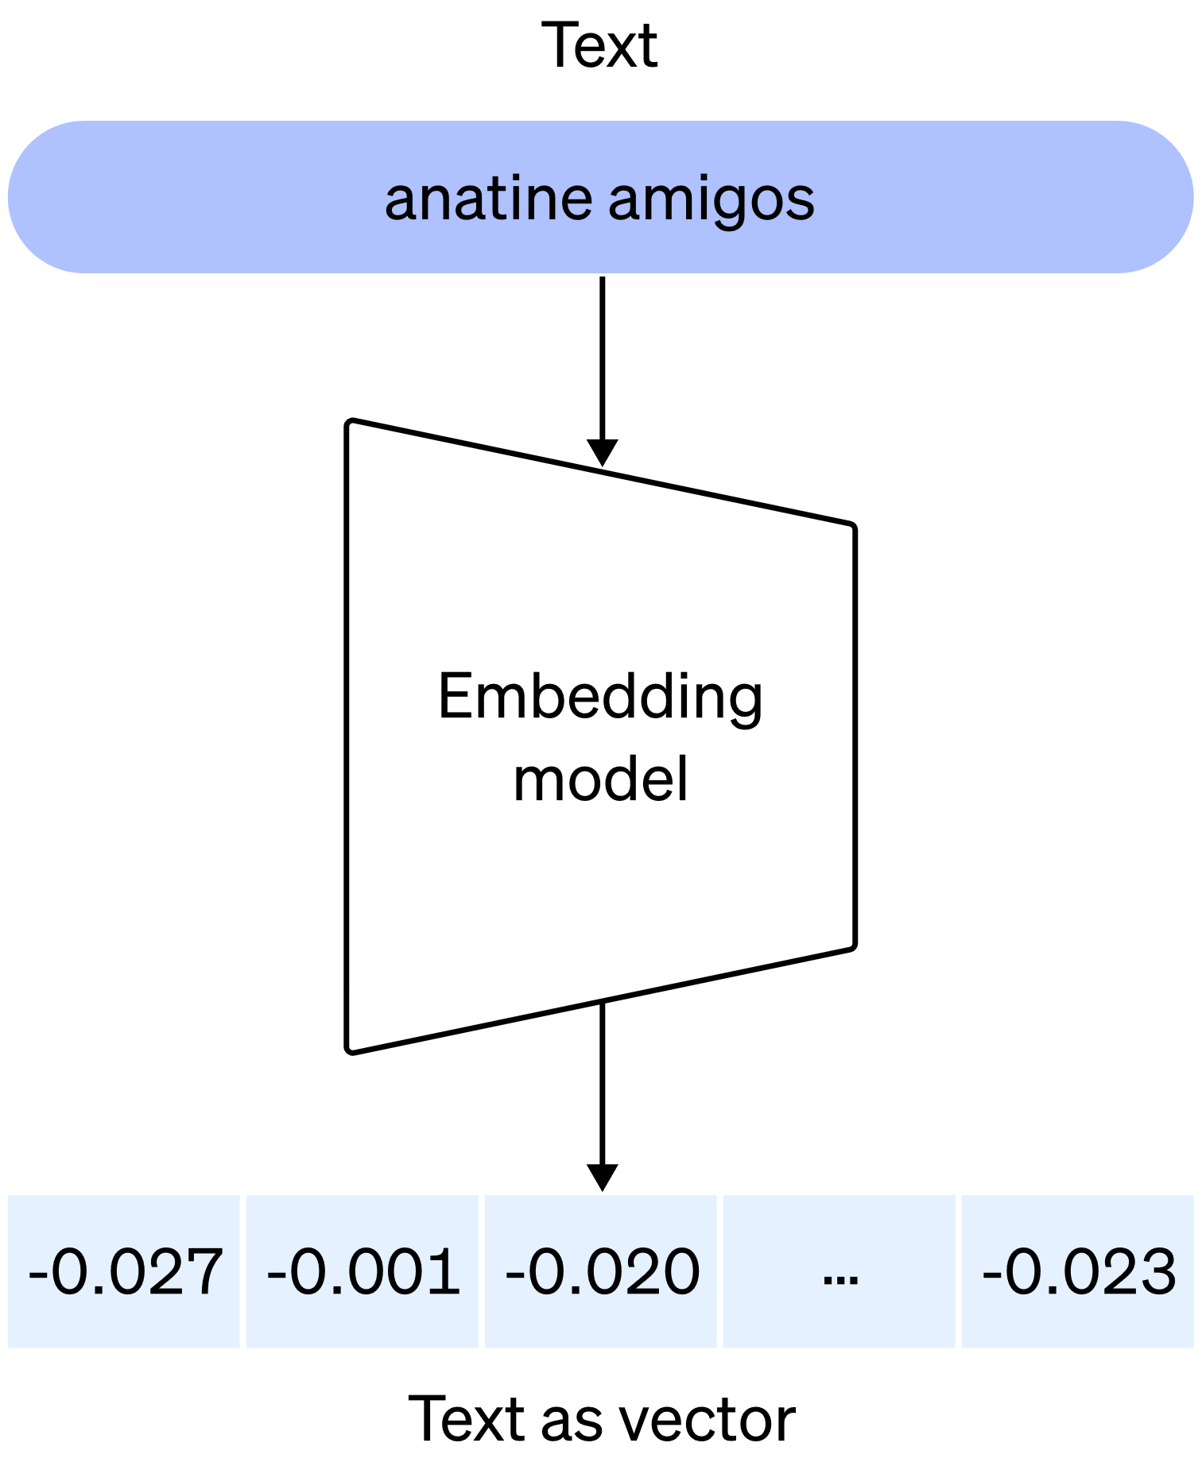
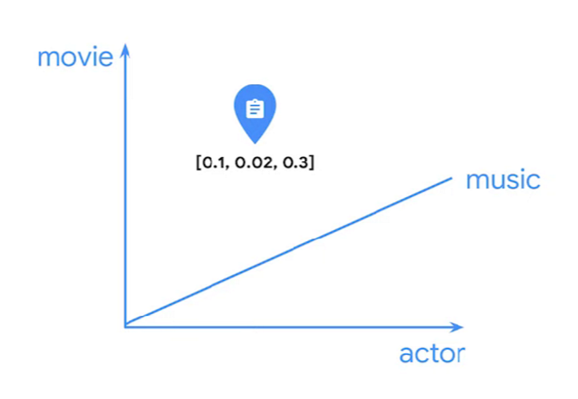
Multimodal Search
Embedding
An embedding is a relatively low-dimensional space into which you can translate high-dimensional vectors.
Embedding is the process of creating vectors using deep learning. An "embedding" is the output of this process — in other words, the vector that is created by a deep learning model for the purpose of similarity searches by that model.

Slide 15
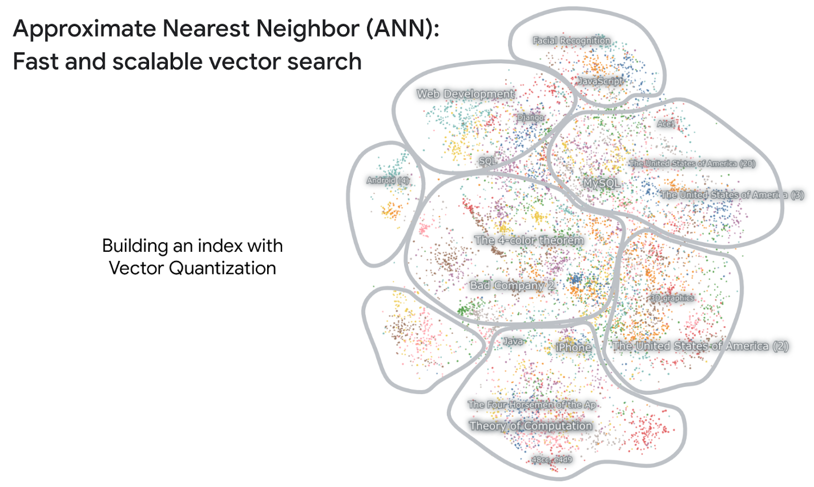
Multimodal Search
Unimodal Search

Slide 16
Multimodal Search
Google Multimodal Search

Slide 17
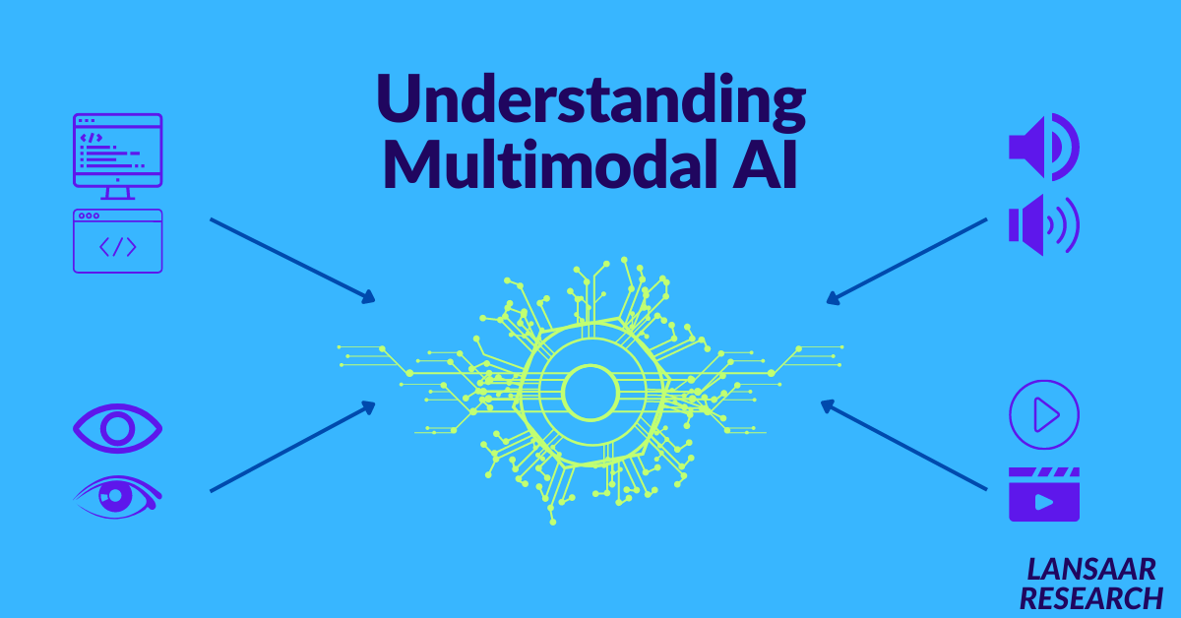
Multimodal Search
What is Multimodal AI?
Multimodal AI is a type of artificial intelligence (AI) that can process, understand and/or generate outputs for more than one type of data（Text/Image/Audio/Video）

Slide 18
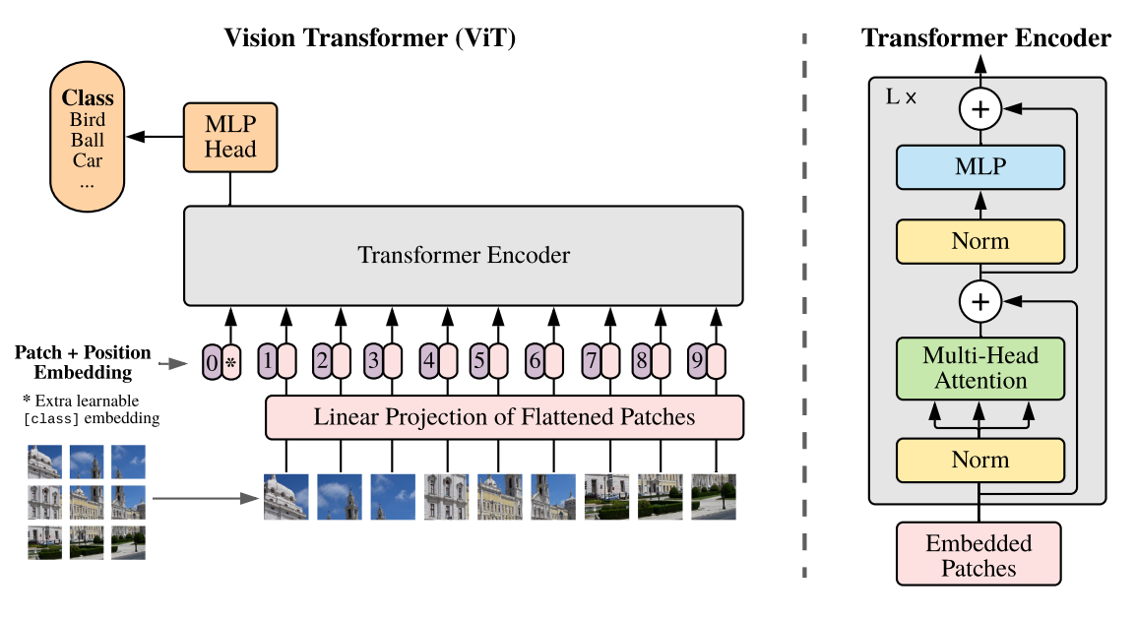
Multimodal Search
Multimodal Architecture
ViT (Vision transformer)
Unimodal encoders/decoders for each input modality
A fusion model for combining the features of the different modalities
A classifier for making predictions based on the fused data

Slide 19

Multimodal Search
Google Multimodal Search
VLM(Vison Language Model) CoCa
The model has three sub-models:
A model to obtain image embeddings
A text model to obtain text embeddings
A model to learn the relationships between them
https://blog.research.google/2022/05/image-text-pre-training-with.html

Slide 20
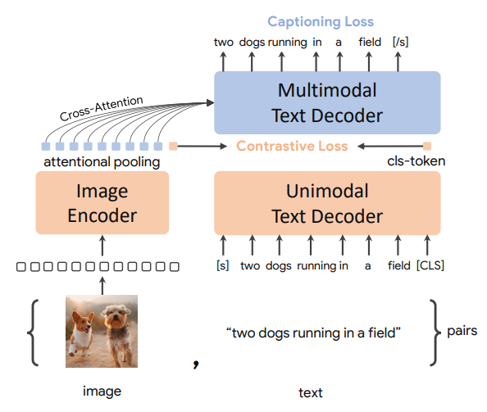
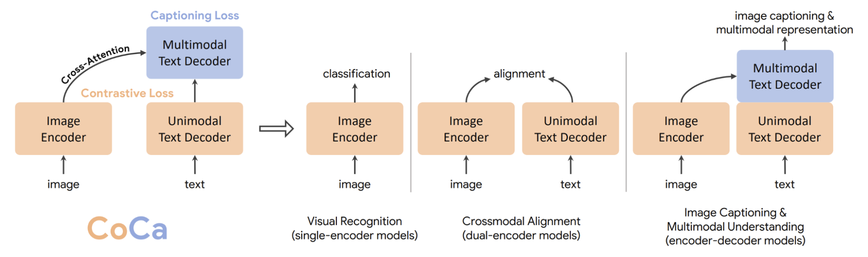
Multimodal Search
VLM(Vison Language Model) CoCa
The model has three sub-models:
A model to obtain image embeddings
A text model to obtain text embeddings
A model to learn the relationships between them
https://arxiv.org/pdf/2205.01917.pdf

Slide 21
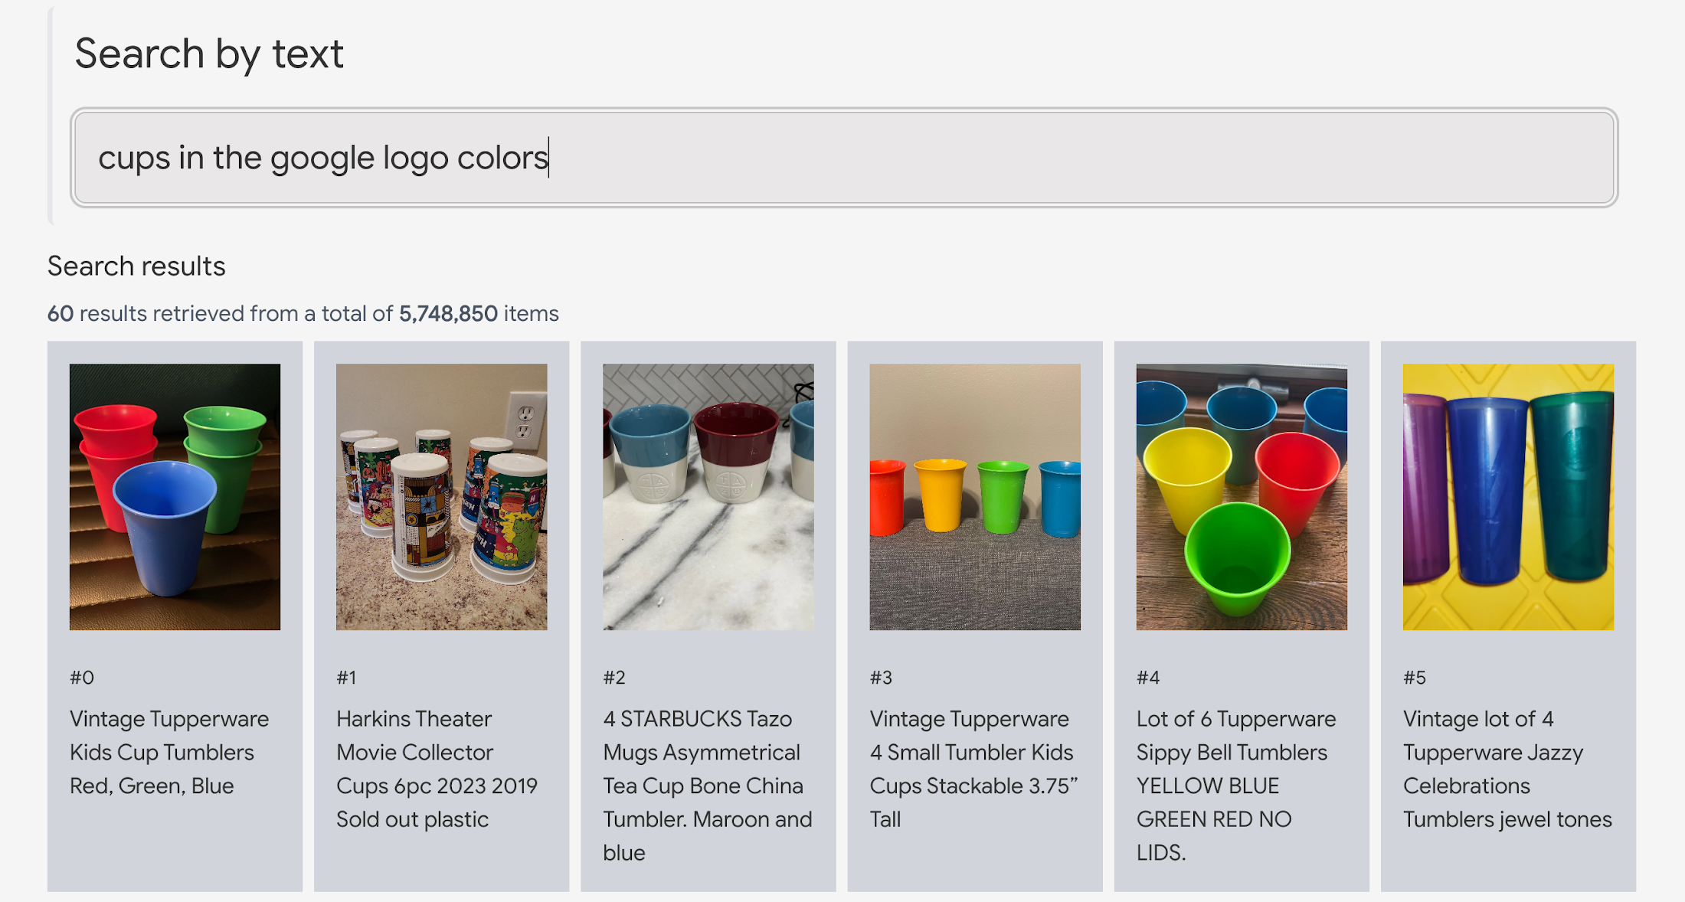
Multimodal Search
Google Multimodal Search
https://ai-demos.dev/

Slide 22
04
Prospect

Slide 23
Prospect
Internal knowledge question and answer/knowledge base application within the company
-Add personalized labels for users.
-Implementation practice of knowledge question and answer application based on AWS
Search Engine Optimization (SEO)，how will AI change the way we optimize for SEO?
-Instead of using lots of keywords for SEO, we can give more descriptive sentences about our pages to fit the user‘s intentions.
-Using AI tools for assisted content creation and content optimization.
-Incorporate Al-powered chatbots and image/voice/video search optimization.
With multimodal, what can we do?
-Business improving, generate product or advertising recommendation words based on images.
-Helps with content creation, search in the asset library for images or videos by text which you want to use.
-Security monitoring, search for potentially dangerous scenarios through text.
-Integrate with recommendation system.
-…
…

Slide 24
Challenge
The implementation of AI-powered searches, though promising, presents certain challenges.
-Data privacy and ethics.
-Technical complexity.
-Integration with existing systems.
-The answers given by generative AI replace people's clicks to enter relevant web pages.

Slide 25
Resources
Vertex AI
The multimodal embedding space with 6 million Mercari items

